Slide 1


Anahata: The Heart Chakra
Yoga Techniques & Fitness / Chakras

Slide 2
Name & Meaning of Anahata
The Unstruck Sound
The fourth of the seven chakras, located at the heart center. Sanskrit anahata = unstruck (the unstruck sound). The energetic seat of love, compassion, connection, and emotional balance. Location: heart center, mid-chest; Kosha association: vijnanamaya kosha — the wisdom sheath.

Slide 3

The Body and Element of Anahata
Physical and Subtle Connections
Anahata manifests in the heart, lungs, and arms, representing air's essence—movement and breath. Its color is a soothing green.

Slide 4
Core Issues: Love and Compassion
Connection and Generosity
The heart chakra is central to our emotional experience. It promotes:
  Love for oneself and others
  Compassion and empathy
  Openness in relationships
  Generosity of spirit
  Together, these qualities foster deeper connections and a sense of belonging within the community.
Anahata encourages a spirit of connection that uplifts:
  Connection with others
  Generosity in giving and receiving
  Openness to new relationships
  This chakra's energy transforms our interactions, creating a nurturing environment where love thrives and emotional ties strengthen.

Slide 5
Core Issues: Forgiveness & Grief
Embracing Emotional Balance
The heart chakra governs essential emotional themes, including:
  Forgiveness: Letting go of past hurts
  Grief: Acknowledging loss to heal
  Belonging: The right to love and be loved
  These themes reflect our capacity to connect deeply with ourselves and others.
A balanced Anahata allows for:
  Healing relationships through forgiveness
  Processing grief constructively
  Fostering a sense of belonging in communities
  Nurturing these aspects leads to profound emotional well-being and connection with our shared humanity.

Slide 6
Signs of Imbalanced Anahata
Understanding the heart chakra's challenges
  Closed-off body posture indicates defensiveness
  Fear of intimacy leads to trust issues
  Isolation or codependency affects relationships
  Grief manifests as tightness in the chest
  Emotional disconnection from self and others

Slide 7

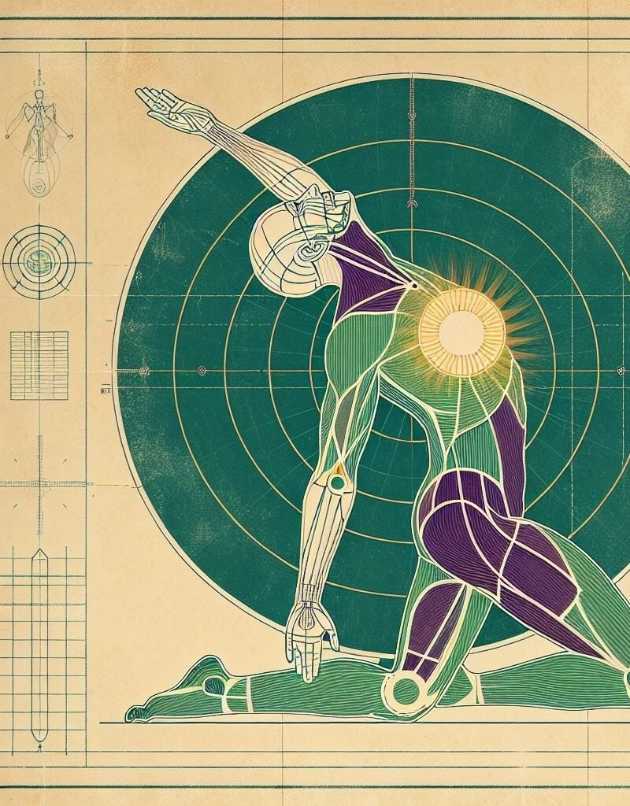
Mantra & Geometry
Sonic Architecture of Anahata

Slide 8

Yoga Practices for Anahata
Backbends
Pranayama
Loving-Kindness
Backbends like Ustrasana and Bhujangasana open the chest, creating space for breath and energy flow, empowering love and compassion.
Extended exhalation in pranayama calms the nervous system, promoting emotional balance and connection to the heart chakra's energy.
Loving-kindness meditation fosters self-love and compassion, reinforcing connections with oneself and others, crucial for a balanced heart chakra.

Slide 9


Continue Your Journey with Us
Email Address
michael@ashtanga.tech
Social Media
@ashtanga.tech · @mjh.yoga
YouTube
@mjhyoga

